Slide 1
Linear regression

Slide 2
Linear Regression is a machine learning algorithm based on supervised learning.
It performs a regression task.
Regression models a target prediction value based on independent variables.
It is mostly used for finding out the relationship between variables and forecasting.
Different regression models differ based on – the kind of relationship between dependent and independent variables, they are considering and the number of independent variables being used.

Slide 3
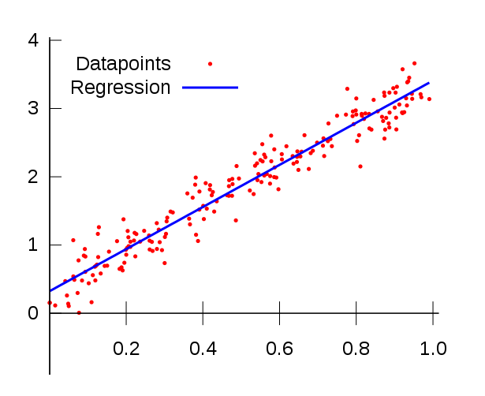
What is Regression Problem?
In regression problem the goal of the algorithm is to predict real-valued output.
Problem Setting
Sales (in thousands of units) for a particular product as a function of advertising budgets (in thousands of dollars) for TV, radio, and newspaper media. Suppose that in our role as statistical consultants we are asked to suggest.
(1). We want to find a function that given input budgets for TV, radio and newspaper predicts the output sales.
(2). Which media contribute to sales?
(3). Visualize the relationship between the features and the response using scatter plots.

Slide 4

Linear regression is used to predict a quantitative response Y from the predictor variable X.
Linear Regression is made with an assumption that there’s a linear relationship between X and Y.
Form of Linear Regression
Mathematically, we can write a linear relationship as:
Where:
y is the response
β values are called the model coefficients. These values are “learned” during the model fitting/training step.
β0 is the intercept
β1 is the coefficient for X1 (the first feature)
βn is the coefficient for Xn (the nth feature)

Slide 5
What Happens In The Training Process?
Model Coefficients/Parameters
When training a linear regression model it’s way to say we are trying to find out a coefficients for the linear function that best describe the input variables.
Cost Function (Loss Function)
When building a linear model it’s said that we are trying to minimize the error an algorithm does making predictions, and we got that by choosing a function to help us measure the error also called cost function.
How Do We Estimate The Coefficients?
For that task there’s a mathematical algorithm called Gradient Descent.
Start with some values of the coefficients/parameters, eg. β0=0, β1=0
Keep changing B0 and B1 to reduce the J(B0, B1) until we hopefully end up at a minimum.

Slide 6
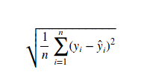
Model evaluation metrics for regression
Evaluation metrics for classification problems, such as accuracy, are not useful for regression problems. Instead, we need evaluation metrics designed for comparing continuous values, such as Root Mean Squared Error (RMSE),
Root Mean Squared Error is the square root of the mean of the squared errors(MSE), MSE by itself can be used for evaluation metric, but that it’s subject for another post.

Slide 7

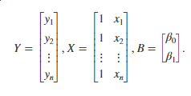
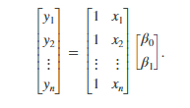
Simple linear regression considers only one independent variable using the relation
where β₀ is the y-intercept, β₁ is the slope (or regression coefficient), and ϵ is the error term.
Start with a set of n observed values of x and y given by (x₁,y₁), (x₂,y₂), ..., (x_{n},y_{n}). Using the simple linear regression relation, these values form a system of linear equations. Represent these equations in matrix form as
Let i.e AX=B
Find B using matrix realtion.

Slide 8
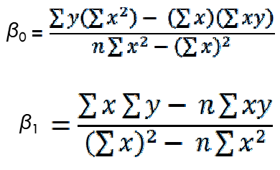
Manual calculation for linear regression
For all (xi,y_{i})
where i=1,2,3,….n

Slide 9
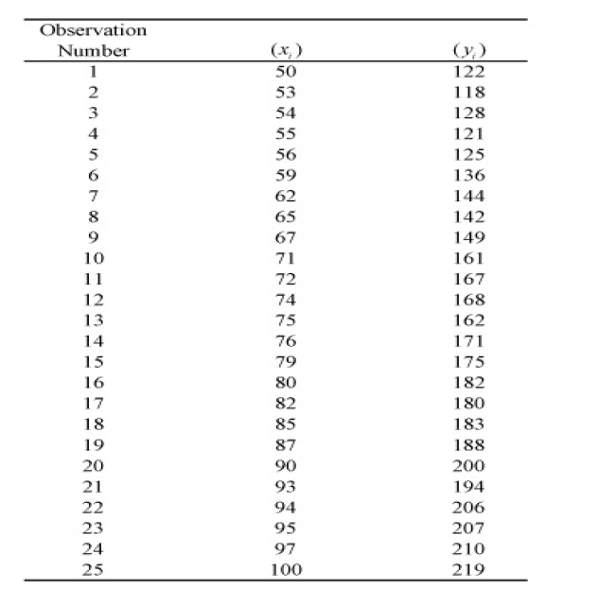

Slide 10
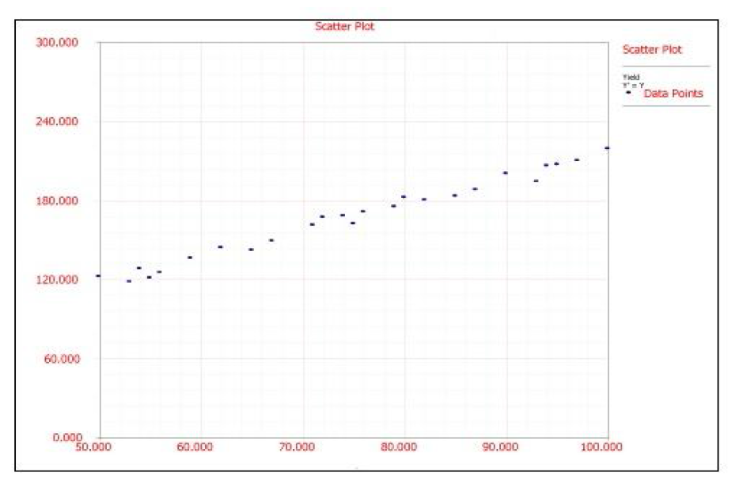
Scatter Plot of given data set

Slide 11
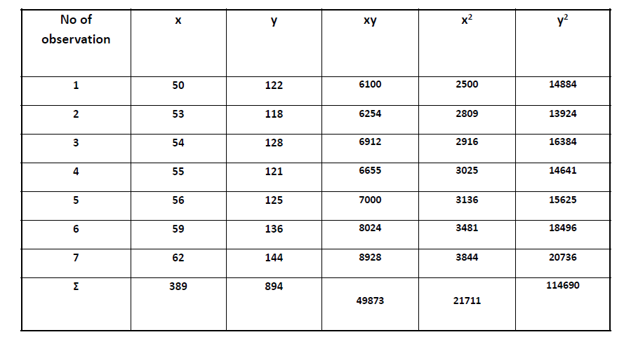

Slide 12
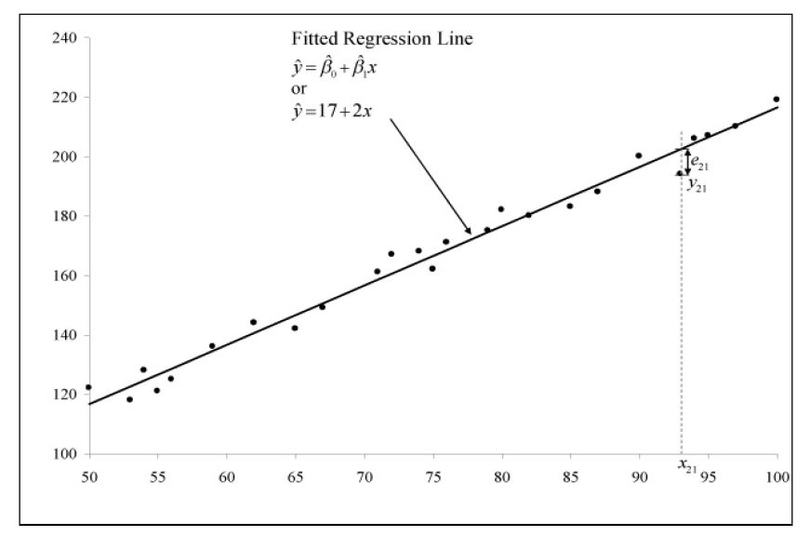
Fitted Regression Curve

Slide 13
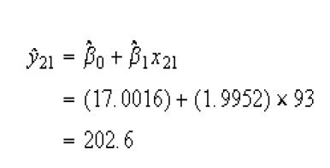
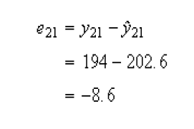
Calculating Error
Once the fitted regression line is known, the fitted value of corresponding to any observed data point can be calculated. For example, the fitted value corresponding to the 21st observation in Table is:

Slide 14
